Slide 1
Manufacturing Scheduling problem with Reinforcement Learning
아주대학교 일반대학원 M&S Lab
작성: 안상현(석사과정)
학번: 202124308
지도교수: 박상철

Slide 2
Index
Scheduling problem
Problem define
Computation number of cases about example
Heuristic approach
Reinforcement Learning approach

Slide 3
Scheduling problem
Demand ( minimize Due date violation )
- These are input on system and Requirements from client’s statement.
- Demand conclude these characteries.
[Type]: Product information such as model name, model dimension or serial number.
[Quantity]: Necessary volume or time.
[Due date]: An Upper Limit time by client.
Schedule Table ( minimize Set-up time )
- It is output on system and showing manufacturing schedule.
- Schedule table conclude these characteries.
[Machine Capability]: Number of Machine and Machine’s capacity.
[Set-up]: Loss cost or time when same machine change another model.
[Id]: Unique demand code, machine information etc.

Slide 4
Scheduling problem(Example)
Demand
Demand id | Type | Quantity(EA) | Due date(Hours)
1 | A | 3,500 | 8
2 | B | 5,200 | 3
3 | C | 4,700 | 4
4 | B | 6,900 | 8
Schedule Table
Line spec: 3 Machines, Machine spec: capacity is 2,000 EA / hour, Set-up time: 2-hr
Demand id | Machine id | Type | P time | S time | C time | Due date | Set-up | Violation time
1 | 0 | A | 2 | 0 | 2 | 8 | False | 0
2 | 1 | B | 3 | 0 | 3 | 3 | False | 0
3 | 2 | C | 3 | 0 | 3 | 4 | False | 0
4 | 2 | B | 4 | 5 | 9 | 8 | True | 1

Slide 5
Scheduling problem(Set-up Solving)
Schedule Table
Line spec: 3 Machines, Machine spec: capacity is 2,000 EA / hour, Set-up time: 2-hr
Demand id | Machine id | Type | P time | S time | C time | Due date | Set-up | Violation time
1 | 0 | A | 2 | 0 | 2 | 8 | False | 0
2 | 1 | B | 3 | 0 | 3 | 3 | False | 0
3 | 2 | C | 3 | 0 | 3 | 4 | False | 0
4 | 2 | B | 4 | 5 | 9 | 8 | True | 1
Improvement
Demand id | Machine id | Type | P time | S time | C time | Due date | Set-up | Violation time
1 | 0 | A | 2 | 0 | 2 | 8 | False | 0
2 | 1 | B | 3 | 0 | 3 | 3 | False | 0
3 | 2 | C | 3 | 0 | 3 | 4 | False | 0
4 | 0 | B | 4 | 4 | 8 | 8 | True | 0

Slide 6
Scheduling problem(Non-Set-up Solving)
Schedule Table
Line spec: 3 Machines, Machine spec: capacity is 2,000 EA / hour, Set-up time: 2-hr
Demand id | Machine id | Type | P time | S time | C time | Due date | Set-up | Violation time
1 | 0 | A | 2 | 0 | 2 | 8 | False | 0
2 | 1 | B | 3 | 0 | 3 | 3 | False | 0
3 | 2 | C | 3 | 0 | 3 | 4 | False | 0
4 | 2 | B | 4 | 5 | 9 | 8 | True | 2
Improvement
Demand id | Machine id | Type | P time | S time | C time | Due date | Set-up | Violation time
1 | 0 | A | 2 | 0 | 2 | 8 | False | 0
2 | 1 | B | 3 | 0 | 3 | 3 | False | 0
3 | 2 | C | 3 | 0 | 3 | 4 | False | 0
4 | 1 | B | 4 | 3 | 7 | 8 | False | 0

Slide 7
Problem define
Number of Machines in single line(M) = 17
A single machine capacity = 1,000 EA/hour
Number of Kinds about Products(P) = 8 (A, B, C, D, E, F, G, H)
Max order quantity in a requirement(Max Q) = 8,000 EA
Min order quantity in a requirement(Min Q) = 100 EA
Max due date about a requirement(Max T) = 12 hours
Set-up time = 1 hour
Max time of a single demand statements = a week(7 days, 148 hours)
Random sample method: Simple random sampling in uniform distribution

Slide 8
Problem define(Demand statement pseudo code)
Due date decision
148 * 17 237 = 2516
2516 – 17(setuptime) = 2499
2499 * 0.7 (30% buffer) = 1750
You can assign job by 1750
Due date offset decision
0을 17번 순회하면, 17개의 단위로
Trim top 30%을 선정
그 top 30%을 offset으로
다시 Due date start time offset
while( cumulated Due date until (Week hours * M - (Set-up time * M) * 0.7 )
{
for index = 1 to M
{
Quantity = random integer; range Min Q to Max Q
Processing Time = Ceil(Quantity / M)
Due Date = random integer; range Processing Time to Max T
Due Date = DueDate + Offset
Type = random character P
}
Offset = Offset + Trim Top 30% about max Due Date in M
}

Slide 9
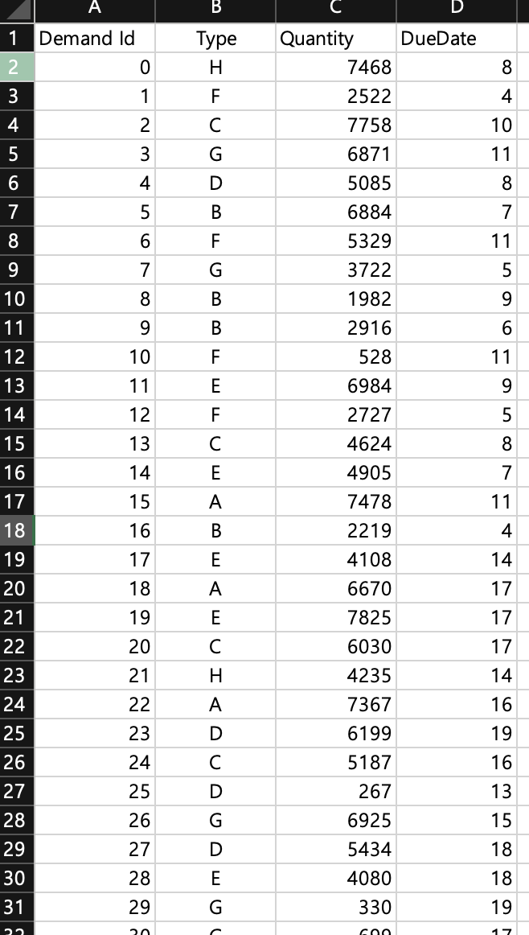
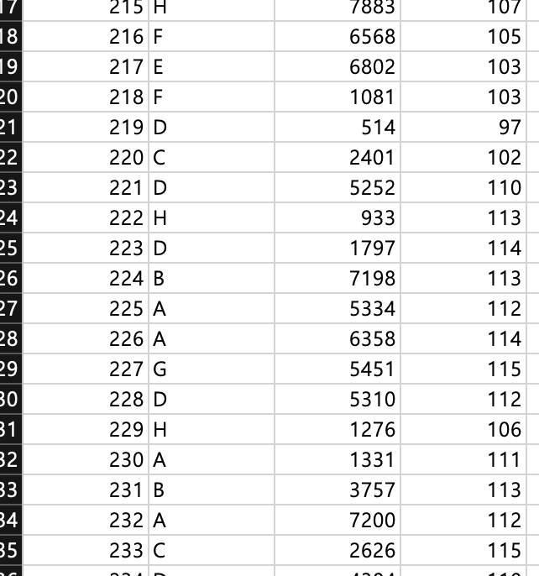
Demand Statement example

Slide 10
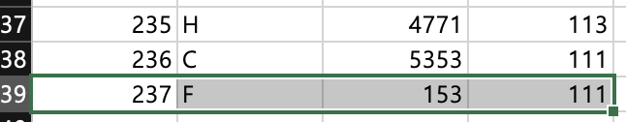
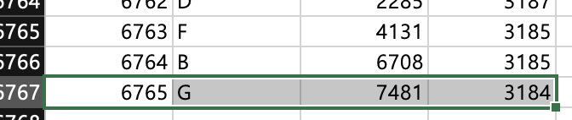
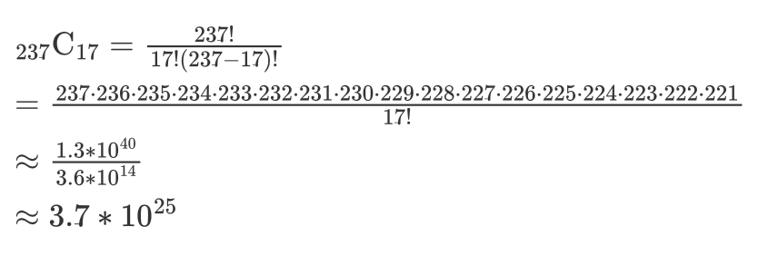
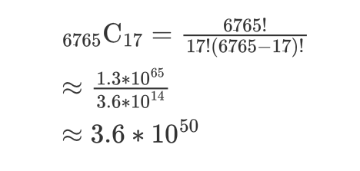
Computation number of cases about example
Case 1: For a week
Case 2: For a month

Slide 11
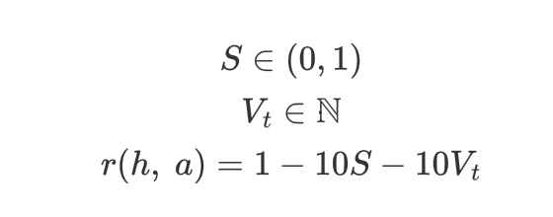
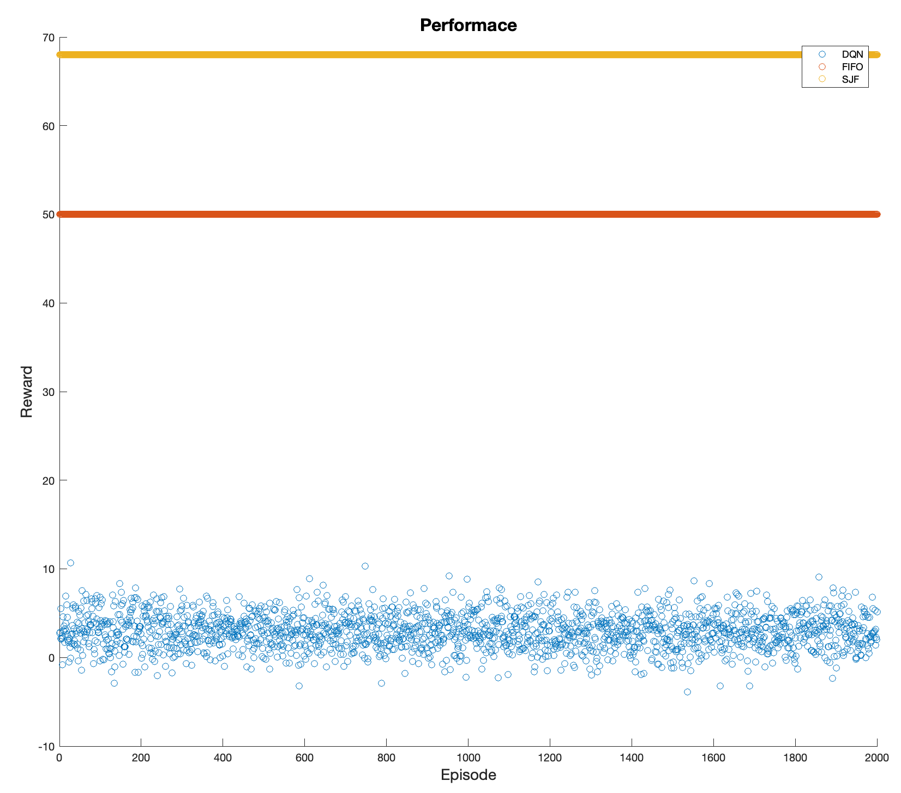
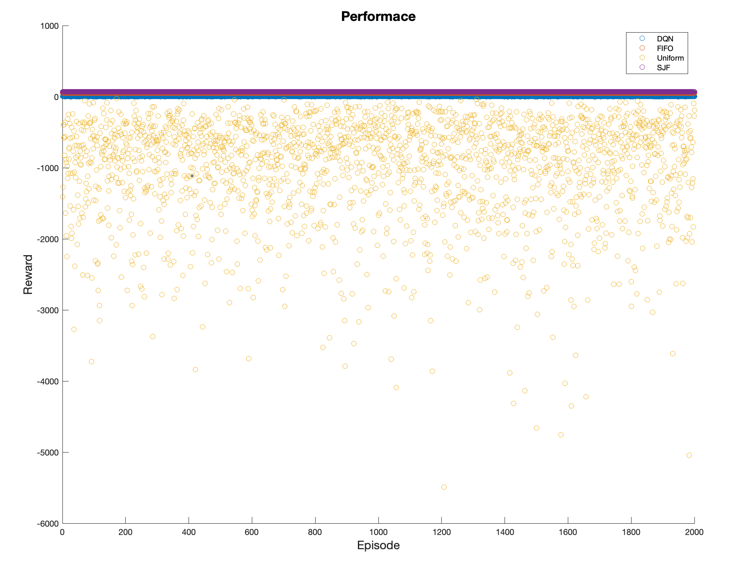
Reinforcement Learning approach
Reward function

